Slide 1


Loki D’Agostino
19th June 2025

Slide 2

Outline
Executive Summary
Introduction
Methodology
Results
Conclusion
Appendix

Slide 3
Executive Summary
Summary of methodologies
-Data Collection through API and Web scraping
-Data Wrangling
-Exploratory Analysis with SQL and matplotlib
-Interactive Visual Analytics with Folium & Dash
-Machine Learning Predictions
Summary of all results
-Result from Exploratory Analysis
-Results from Interactive Visual Analytics
-Results from Predictive Machine Learning

Slide 4
Introduction
Project background and context
SpaceX advertises Falcon 9 rocket launches from $62 million, while alternative companies advertise similar rocket launches at prices upwards of $165 million. SpaceX’s ability to offer launches at a substantially lower price is due to their ability to reuse the first stage in the Falcon 9 launch system.
Problems you want to find answers.
What are the factors that contribute to successful booster landing?
What are the ideal conditions for a successful booster landing?

Slide 5

Section 1

Slide 6
Methodology
Executive Summary
Data collection methodology:
Data was collected through the SpaceX API and also from scraping the “Falcon 9 first-stage landing tests” Wikipedia page.
Perform data wrangling
Converted the 8 types of mission outcomes into a binary Failed (0) or Successful(1)
Performed One-hot encoding on all other categorical features.
Perform exploratory data analysis (EDA) using visualization and SQL
Perform interactive visual analytics using Folium and Plotly Dash
Perform predictive analysis using classification models
How to build, tune, evaluate classification models

Slide 7
Data Collection
Describe how data sets were collected.
Data collection was done via a get request to the SpaceX API.
Next, we decoded the response as a Json using .json() function and then turn it into a pandas dataframe using .json_normalize().
We then cleaned the data, checked for missing values and fill in missing values where necessary.
In addition, we performed web scraping from Wikipedia for Falcon 9 launch records with BeautifulSoup.
The objective was to extract the launch records as HTML table, parse the table and convert it to a pandas dataframe for future analysis.
You need to present your data collection process use key phrases and flowcharts

Slide 8
Data Collection
Get Request to SpaceX API
Web scraped dat from Wikipedia “Falcon 9 first-stage landing tests”
Final Data
.json() and .json_normalize()
To a data frame
Beautiful Soup

Slide 9
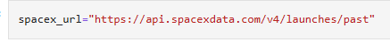
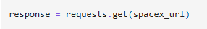
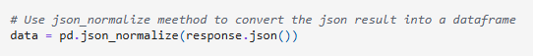
Data Collection – SpaceX API
Present your data collection with SpaceX REST calls using key phrases and flowcharts
Add the GitHub URL of the completed SpaceX API calls notebook https://github.com/loki-dag/fullproj/blob/main/Hands-on%20Lab_%20Complete%20the%20Data%20Collection%20API%20Lab.ipynb

Slide 10
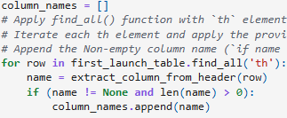
Data Collection - Scraping
Present your web scraping process using key phrases and flowcharts
Add the GitHub URL of the completed web scraping notebook, as an external reference and peer-review purpose
Parse the data into a dictionary then convert into a Data frame.

Slide 11
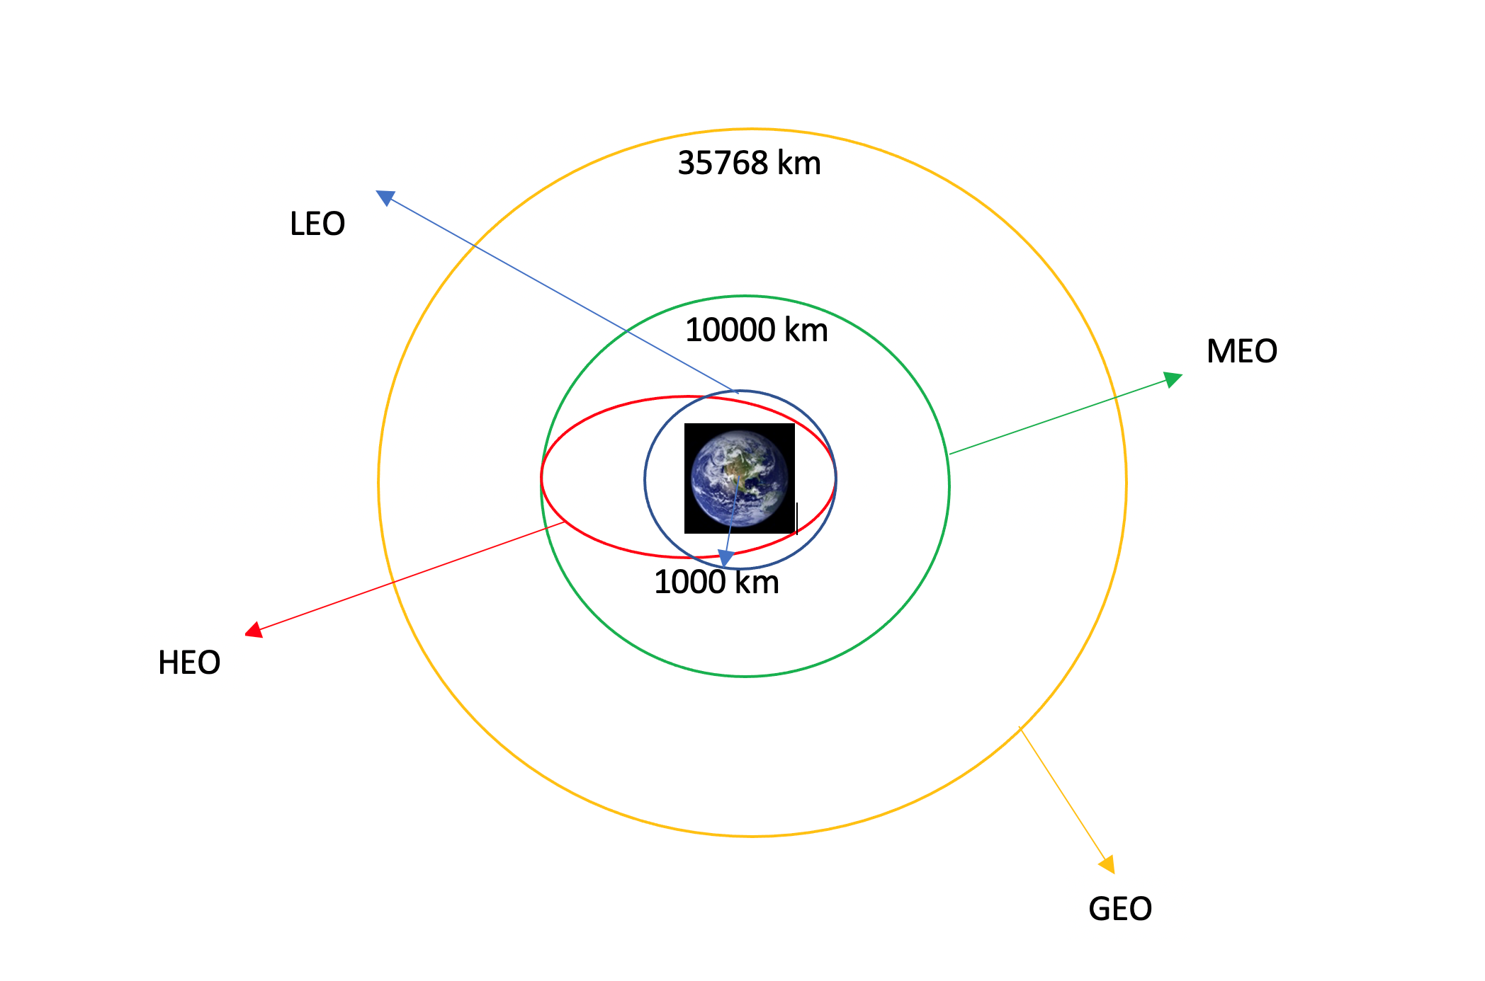
Data Wrangling
We used exploratory data analysis to set the training labels
Calculated the number of launches from each site, and the number of each type of orbit.
Created a landing outcome variable.
Exported data into a CSV
https://github.com/loki-dag/fullproj/blob/main/labs-jupyter-spacex-Data%20wrangling-v2.ipynb

Slide 12
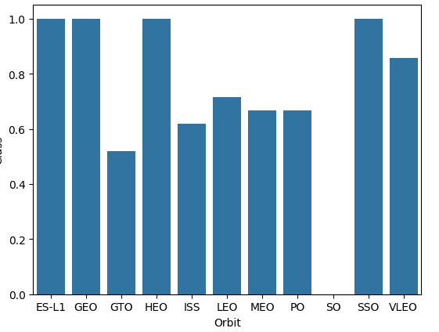
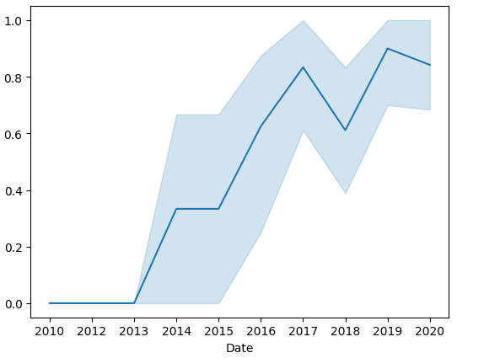
Success rate vs Orbit type
EDA with Data Visualization
We explored the data by visualizing the relationship between flight number and launch Site, payload and launch site, success rate of each orbit type, flight number and orbit type, the launch success yearly trend.
Success rate per year
https://github.com/loki-dag/fullproj/blob/main/labs-jupyter-spacex-Data%20wrangling-v2.ipynb

Slide 13
EDA with SQL
Using bullet point format, summarize the SQL queries you performed
Distinct Launch Sites
Sum (total) payload mass launched for NASA
Average Payload mass sent by the F9 v1.1
Date of the first successful landing
names of the boosters which have success in drone ship and have payload mass greater than 4000 but less than 6000
total number of successful and failure mission outcomes
all the booster_versions that have carried the maximum payload mass
Gathered the most occurring mission outcomes.
https://github.com/loki-dag/fullproj/blob/main/jupyter-labs-eda-sql-coursera_sqllite.ipynb

Slide 14
Build an Interactive Map with Folium
We marked all launch sites, and added map objects such as markers, circles, lines to mark the success or failure of launches for each site on the folium map.
We assigned the feature launch outcomes (failure or success) to class 0 and 1.i.e., 0 for failure, and 1 for success.
Using the color-labeled marker clusters, we identified which launch sites have relatively high success rate.
We calculated the distances between a launch site to its proximities. We answered some question for instance:
Are launch sites near railways, highways and coastlines.
Do launch sites keep certain distance away from cities.
https://github.com/loki-dag/fullproj/blob/main/lab-jupyter-launch-site-location-v2.ipynb

Slide 15
Build a Dashboard with Plotly Dash
We built an interactive dashboard with Plotly dash
We plotted pie charts showing the total successful launches by site, and also pie charst showing the relationship between launch site and success rate.
We plotted a scatter plot showing the relationship with Outcome and Payload Mass (Kg) for the different booster version.
https://github.com/loki-dag/fullproj/blob/main/dash_interactivity.py

Slide 16
Predictive Analysis (Classification)
We loaded the data using numpy and pandas, transformed the data, split our data into training and testing.
We built different machine learning models and tune different hyperparameters using GridSearchCV.
We used accuracy as the metric for our model, improved the model using feature engineering and algorithm tuning.
We found the best performing classification model.
https://github.com/loki-dag/fullproj/blob/main/SpaceX_Machine%20Learning%20Prediction_Part_5.ipynb

Slide 17
Predictive Analysis (Classification)
Creating a NumPy array from the column “Class” in data
Standardizing the data with StandardScaler, then fitting and transforming it
Splitting the data into training and testing sets with train_test_split function
Creating a GridSearchCV object with cv = 10 to find the best parameters
Finding the method performs best by examining the Jaccard_score and F1_score metrics
Applying GridSearchCV on LogReg, SVM, Decision Tree, and KNN models
Examining the confusion matrix for all models
Calculating the accuracy on the test data using the method .score() for all models

Slide 18

Section 2

Slide 19
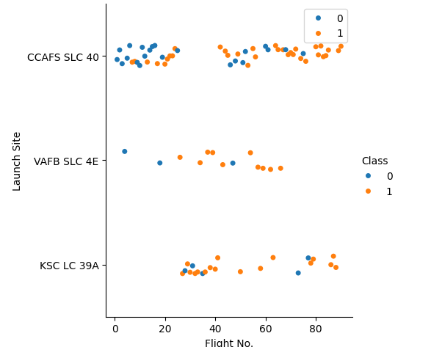
Flight Number vs. Launch Site
Earlier flights failed more often, late flights succeeded more often
CCAFS SLC 40 site had about half the total launches
The other two sites have a higher overall success rate, this may be due to them starting launching later than CCAFS SLC 40

Slide 20
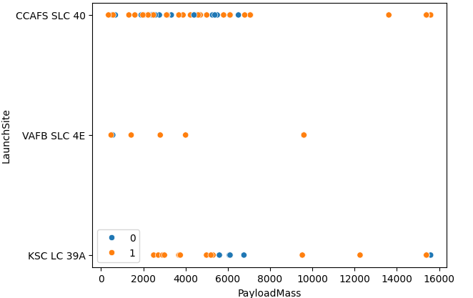
Payload vs. Launch Site
Most of the launches with payload mass over 7000 kg were successful.
KSC LC 39A has a 100% success rate for payload mass under 5500 kg too.

Slide 21
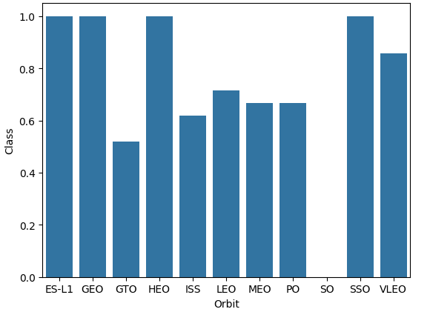
Success Rate vs. Orbit Type
ES-L1, GEO, HEO, & SSO had 100% success rates
SO had a 0% success rate
Other orbits had a success rate between ~85% and ~55%:
- GTO, ISS, LEO, MEO, PO, VLEO

Slide 22
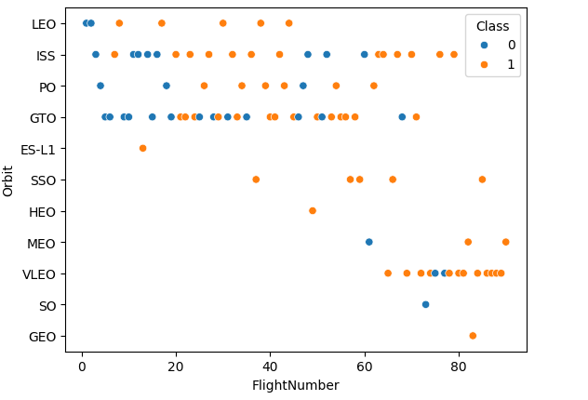
Flight Number vs. Orbit Type
LEO was the first type of Orbit attempted, while ISS was the first type of orbit sucessfuly achieved
VLEO had the most recent failed outcome
SSO and VLEO were the 2 most recent high attempt volume Orbits

Slide 23
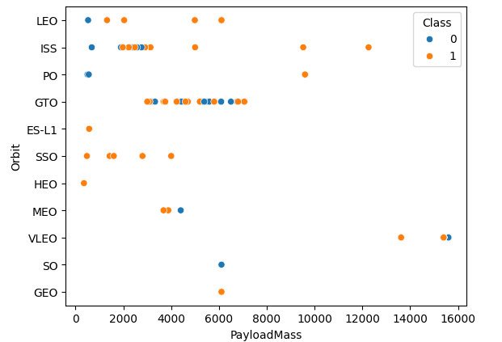
Payload vs. Orbit Type
VLEO missions take the highest payload to space.
Most GTO launches are between ~3000kg and ~8000kg.
Most ISS launches are between ~2000kg and ~4000kg.

Slide 24
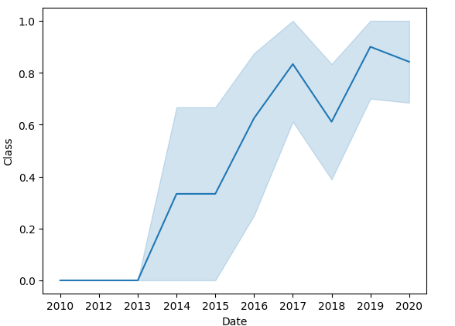
Launch Success Yearly Trend
It can be observed that the success rate was 0% for all years prior to 2014
2014 onwards the observed trend is that each year there is an increase in the rate successful missions
2018 is an observed outlier to the year on year trend.
As of 2020, the trend might plateu

Slide 25
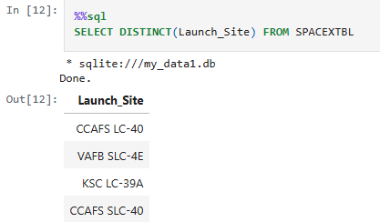
All Launch Site Names
There are 4 different launch sites

Slide 26
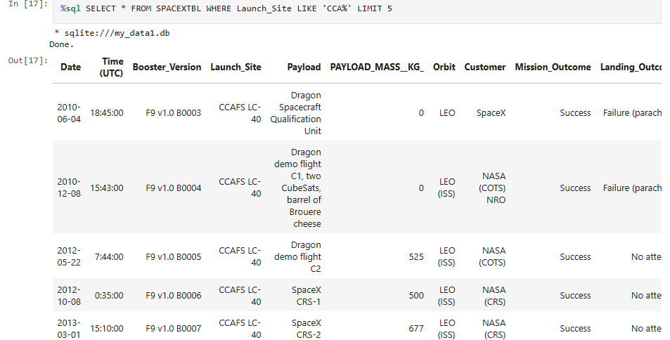
Launch Site Names Begin with 'CCA'

Slide 27
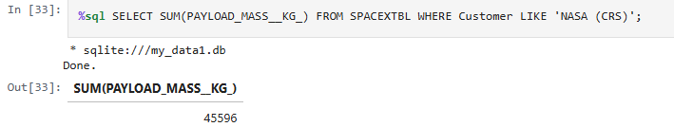
Total Payload Mass
Total payload sent by the customer NASA (CRS)

Slide 28
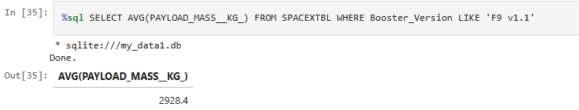
Average Payload Mass by F9 v1.1

Slide 29
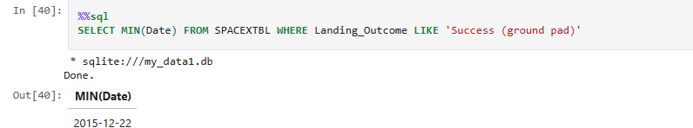
First Successful Ground Landing Date

Slide 30

Successful Drone Ship Landing with Payload between 4000 and 6000

Slide 31
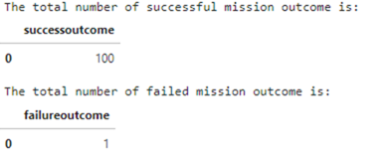
Total Number of Successful and Failure Mission Outcomes

Slide 32
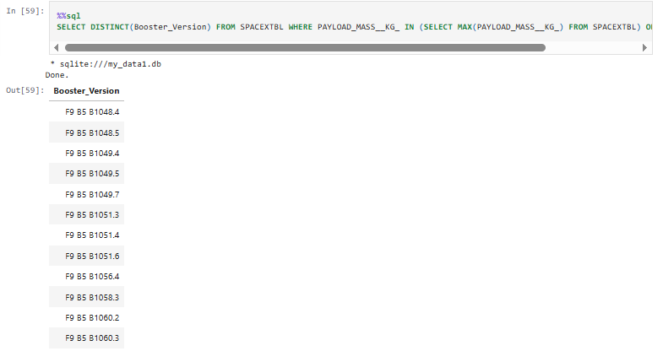
Boosters Carried Maximum Payload

Slide 33
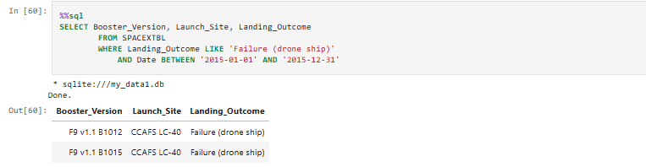
2015 Launch Records

Slide 34
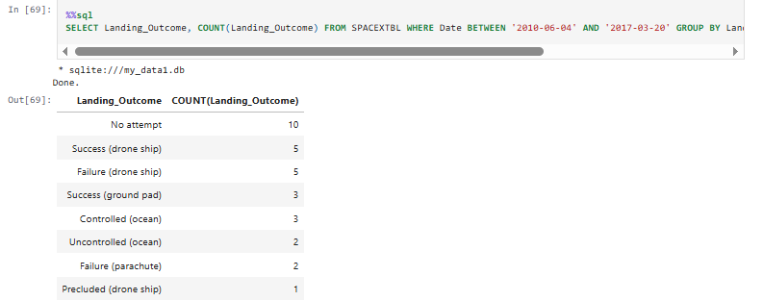
Rank Landing Outcomes Between 2010-06-04 and 2017-03-20

Slide 35

Section 3

Slide 36
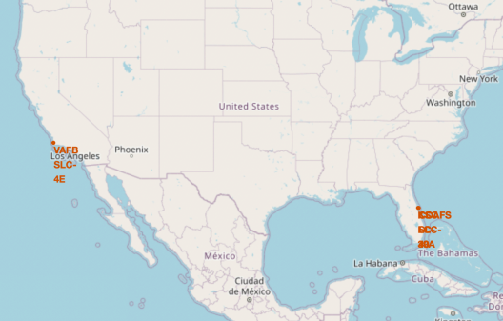
Map of Launch sites
Most launch sites are in Florida
Lone launch site in California
They are located in the southern part of the country because the closer to the equator the launch site is the more velocity is provided in orbit by the earths rotation.
All sites are close to the coast to minimize debris damage.

Slide 37
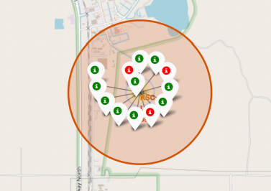
Color labeled launch sites
GREEN = Successful mission
RED = Failed mission
This site (KSC LC-39A) has a very high success rate

Slide 38
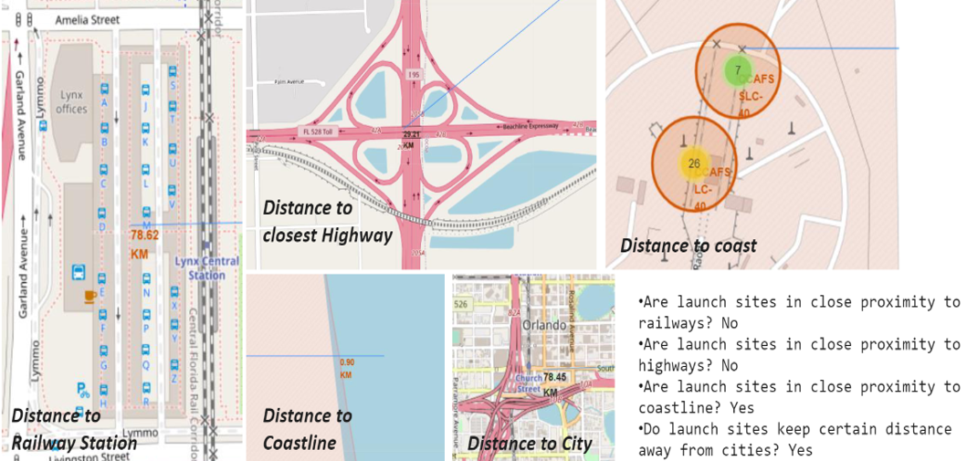
Distance to landmarks

Slide 39

Section 4

Slide 40
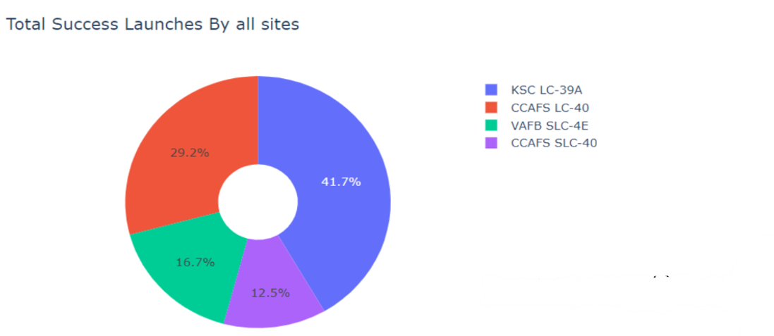
Pie chart showing percentage of total successful launches by launch site

Slide 41
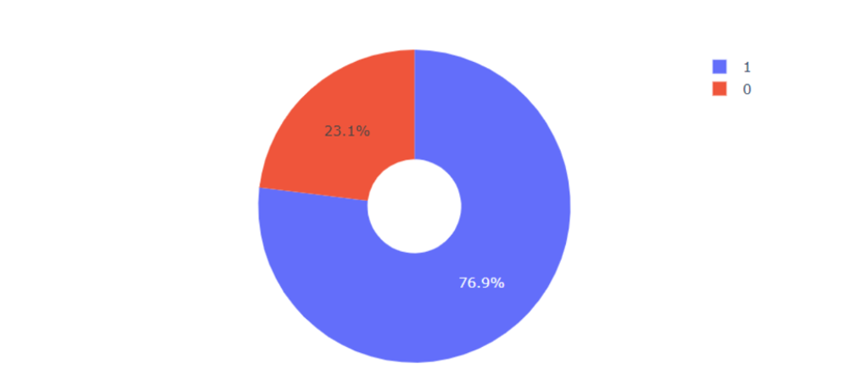
Pie chart showing success rate of site: KSC LC-39A
We can see that KSC LC-39A had a success rate of 76.9%

Slide 42
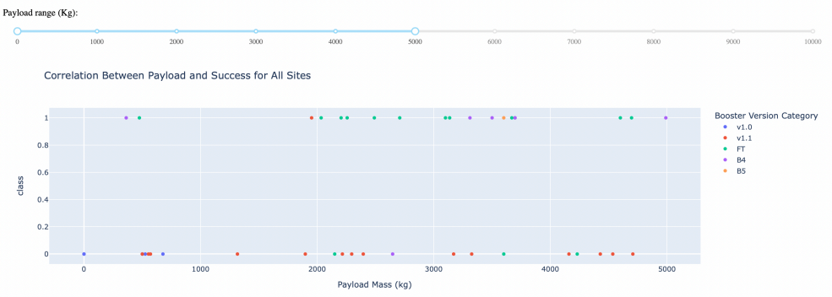
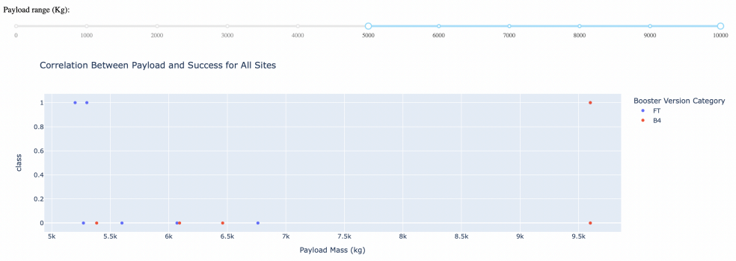
Screen shots of Success or Failure VS paylaod
Notice how the payload range scales with the selected range.

Slide 43

Section 5

Slide 44

Classification Accuracy

Slide 45
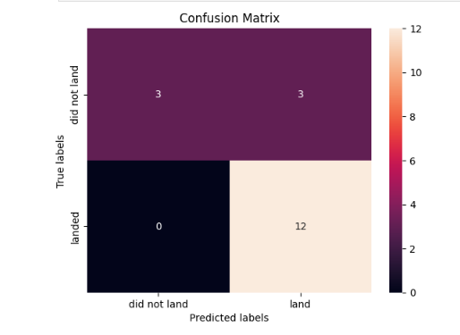
Confusion Matrix

Slide 46
Conclusions
The larger the flight amount at a launch site, the greater the success rate at a launch site.
Launch success rate started to increase in 2013 till 2020.
Orbits ES-L1, GEO, HEO, SSO, VLEO had the most success rate.
KSC LC-39A had the most successful launches of any sites.
The decision tree classifier is the best machine learning model for this task.

Slide 47


